Slide 1
Social groups
Dr. Ayushi Jain
Dept Of Community Physiotherapy
MGM Institute Of Physiotherapy
Chh. Sambhajinagar

Slide 2

introduction
Social group is a basic social unit when two or more persons interacting with each other, interrelationships are directed towards fulfillment of certain common goals or purposes.
Inter-stimulation and response are the key factors in the process of social interaction.

Slide 3
Definition
‘A social group grows out of a situation which permits meaningful inter-stimulation and response between the individuals, focusing of attention on common situation or interest, the development of certain common drives, motivation or emotions.

Slide 4
Characteristics of Group Life
The members of the group are related to each other and possess a sense of ‘we’ feeling.
Group involves a sense of unity
The interests, ideals, values of the group members are common
Similarity of behavior among the group members is observed
There are certain norms, customs and procedures which are acceptable and everyone in the group to obey the norms, rules and regulations of their own group
The members of the group are affected by its characteristics
Homogeneous

Slide 5
Good interpersonal and interactional relationship
Collective perception of their identity and unity
Shares certain goals, values and beliefs
Emerges social control over the behavior
Cooperation
Power relations
Members behave in a natural and relaxed manner
Membership is by voluntary, automatic in informal groups, with some purpose in formal groups
Joining in a group may be motivated by a variety of personal needs
Individuals who has similar values and beliefs will join together

Slide 6
Group Structure
Is based on stability, and becomes structured. Group norms and standards, positions/authority, responsibilities are developed to regulate the actions of its group members.
Group structure may be based on communication, as communication is essential in transforming information and coordinating the activities of individuals in groups.

Slide 7
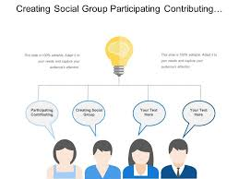
participation
Handling of conflict situation
Job enrichment

Slide 8
Classification
In group • The members in the group will have ‘we’ feeling and a common attitude and treats the group members as one. Eg: Family, group of friends.
• Based on ethnocentrism.
• People exhibit good behaviour with one to another.
Out group • People will develop a sort of hatred feeling on a particular group and treat the group completely away from them.

Slide 9
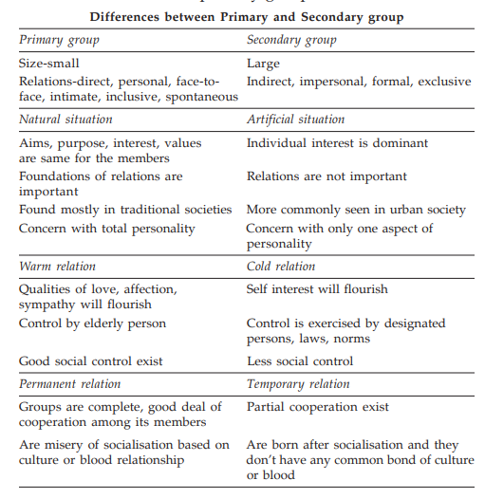

Slide 10
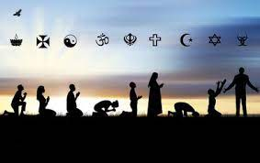
Religious Group

Slide 11
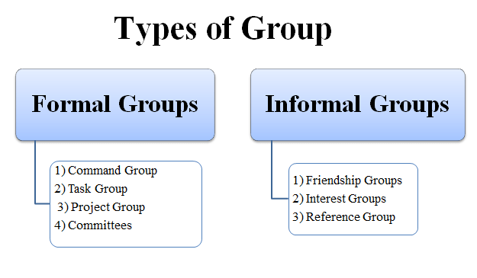
Role of Formal Groups in Health of the Individual
The formal group includes hospital, educational institutions, agencies which provide employment, occupational group, ESI schemes, Government schemes, political group and state.

Slide 12
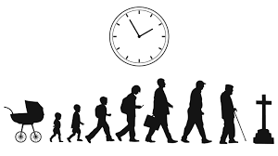
At birth
The health care professional provides necessary preventive and promotive measures for newborn care. Eg: Immunization services, feeding, bathing, rooming-in, socialisation of the child

Slide 13
Toddler, Preschool
Crèche facility, play homes, balawadi, anganwadi teaches the child to share and learn the group responsibilities such as singing, playing, eating, studying, sleeping, rest pattern.

Slide 14
School Age
Schoolmates help the child to develop good companionship, sharing, spending constructively the leisure time activities

Slide 15
Adolescents
The teachers in the colleges act as a role model, counsel the child to keep in right track and good contacts, developing healthy competitive spirit, cooperation, shouldering responsibilities, encouraging individual projects and assignments; brings awareness on sex education.

Slide 16
Adulthood
Healthy working environment, good companion, sound employer and employee relationships, promotes and protects the individual.

Slide 17
Old Age
Providing shelter, healthy atmosphere, concern, assisting in daily living activities, nutritious food, arranging religious services and counselling services are some of the promotive measures.

Slide 18
Role of Formal Group in Sickness of an Individual
In hospital setting, the health care professionals gather the data from client, his family, peer group,
conducts physical examination, laboratory investigations and diagnose the problems of the client;
prioritize the needs of clients, plans appropriate intervention measures, assists the clients in meeting their needs.
Health care professionals will conduct free health camps and provide specialised services within the community at domiciliary level.

Slide 19
In rehabilitation settings, the intellectual levels of client will be assessed by health team members, according to the abilities and limitations skill oriented activities training is given to attain maximum potentiality of the individual.
Certain insurance schemes like ESI benefits, medical and sickness benefits, health allowances, low cost nutritious food, safe drinking water, etc. are implemented to meet the needs of employee.

Slide 20
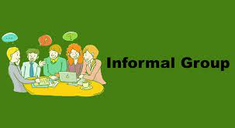
Influence of Informal Groups on Individual Health and Sickness
Family, peer group and playgroup are the components of the informal group

Slide 21
Role of Family
Discussed in next lecture

Slide 22
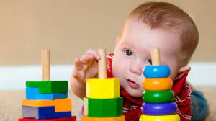
Role of Playgroup
Playmates are helpful in cultivation of healthy recreational habits, sharing and shouldering responsibilities, following norms, rules, regulations, ethical concept, development of good habits

Slide 23
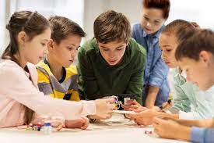
Peer Group
Individual behaviour in positive and negative manner. Eg: Reading habits, recreation habits, visiting worshipping places during leisure times avoiding eating food from unhygienic environment, etc. are some of the positive influences.
The negative influences by the peer group are; cultivation of bad practices like smoking, alcoholism, drug abuse, gambling, internet browsing the unethical sites.

Slide 24
Role of Primary and Secondary Group in Hospitals and Rehabilitation Centres
Primary groups plays vital role in the individual’s life.
It is the nucleus of all social organizations.
Group members have direct contact, closeness, help one another, provide companionship. Family, friends are the components of the primary group.
The needs of the clients in health care settings can be described according to Maslow’s theory of hierarchical needs.
The needs like physiological, safety and security, love and belonging needs of the client are met by the primary group.
The other needs like self-esteem, cognitive, aesthetic and self-actualisation needs will be met by the secondary group.

Slide 25
Role of Secondary Group
The health care professionals are considered as secondary group and play a vital role in fulfilling the specific needs of clients like esteem, cognitive, aesthetic and self-actualisation.
In hospital setup, the health team members establish good interpersonal relationship with the client and develop rapport and win the confidence.
The client will feel ease and comfortable and cooperate with the team members in planning, implementing and the remedial measures either in hospital and rehabilitation settings.
The multidisciplinary team plays their respective roles in fulfilling the cognitive needs of the client by counselling and explaining about the prognosis of the disease

Slide 26
In rehabilitation settings the individual will be given sufficient training by the experts to the highest possible level of function ability.
When the client is able to perform productive role, he actualises himself about his capacities, abilities and limitations and mould himself to accommodate to the changing situations

Slide 27

Any questions?

